Slide 1
Processes and threads - 3

Slide 2


Today we will discuss
Threads
Interprocess Communication （IPC）

Slide 3

Review: Origin of threads
Group related resources together in the form of process to manage resources more easily.
Resource grouping
process
Executing
A process has a thread of execution, which is the entity scheduled for execution on the CPU.
Single-threaded process
Notes:
进程模型基于以下两个独立的概念：资源分组处理与执行。有时，这两个概念分开是有益的，这就是线程的由来。
观察进程的一种方式是，用某种方法把相关的资源集中在一起。进程有存放正文和数据以及其他资源的地址空间，把这些资源都放到进程中更易于管理。
另一个角度是，进程拥有一个执行的线程，拥有与调度相关的所有信息，是在CPU上被调度执行的实体。

Slide 4
Requirements for parallel programs
We need parallel programs, such as:
  Parallel execution on a multiprocessor
  Web server to handle multiple simultaneous web requests
What we will need to:
  Create several processes that can execute in parallel
  Cause each to map to the same address space
    because they’re part of the same computation
  Give each its starting address and initial parameters
  The OS will then schedule these processes in parallel

Slide 5

Problems of using processes
A full process includes numerous things:
  an address space (defining all the code and data pages)
  OS resources and accounting information
  a “thread of control”: defines where the process is currently executing, which is the PC and registers
Creating a new process is costly
  all of the structures (e.g., page tables) that must be allocated
Communicating between processes is costly
  most communication goes through the OS

Slide 6
What we need?
What’s similar in these processes?
  They all share the same code and data (address space)
  They all share the same privileges
  They share almost everything in the process
What don’t they share?
  Each has its own PC, registers, and stack pointer
Idea: why don’t we separate the idea of process (address space, accounting, etc.) from that of the minimal “thread of control” (PC, SP, registers)?

Slide 7
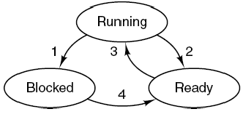
Thread
Thread is an independent and schedulable executing unit, including
  Program counter: as a thread can also be suspended and resumed.
  Registers: as when threads are suspended, their registers must be saved.
  State: as threads can be in running, ready, blocked (waiting) state.
  Stack: to save local information, such as local variables.

Slide 8
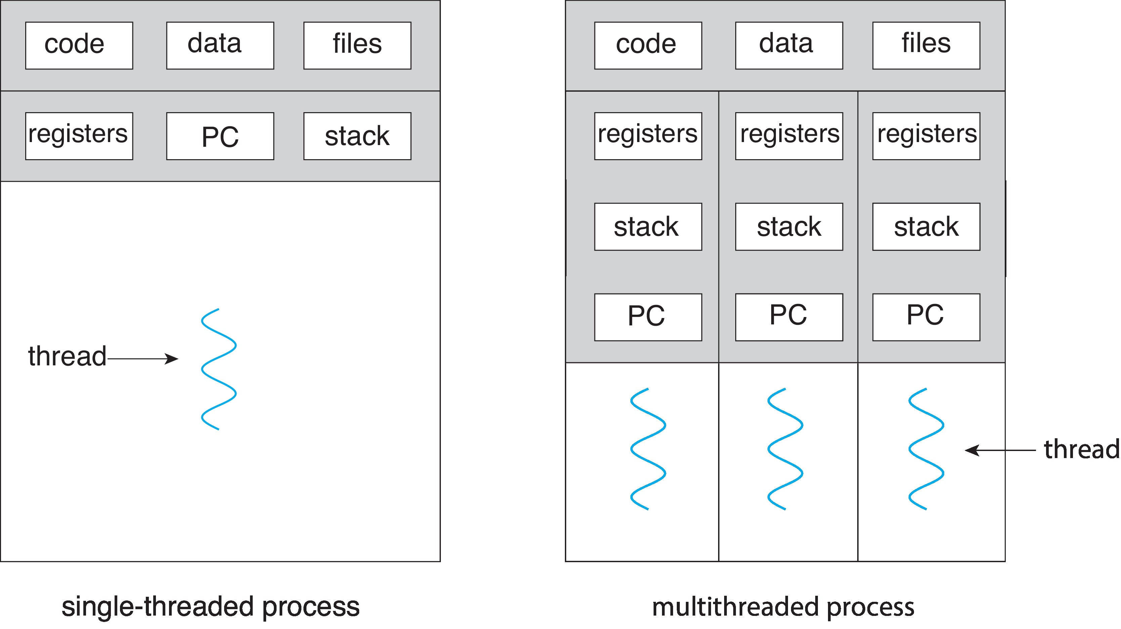
Multithread
Most modern applications are multithreaded
  Threads run within application
  Kernels are generally multithreaded

Slide 9
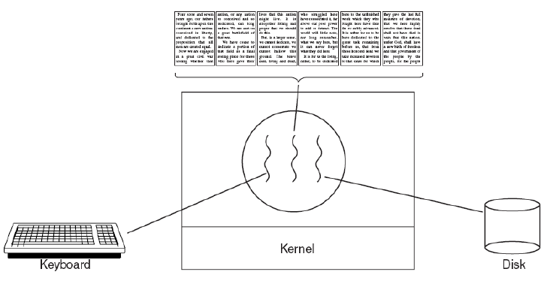
Example-word processor
Discussion: why not multiple processes?
Notes:
如果程序是单线程的，那么进行磁盘备份时，来自键盘和鼠标的命令就会被忽略，直到备份工作完成为止。用户会认为性能很差。另一个方法是，为了获得好的性能，可以让键盘和鼠标事件中断磁盘备份，但这样引入了复杂的中断驱动程序设计模型。
如果使用三个线程，程序设计模型就非常简单，第一个线程只是和用户交互，第二个线程在通知时进行文档的重新格式化，第三个线程周期性地将RAM中的内容写到磁盘上。
显然，在此情况下，三个进程不能工作。因为所有的三个进程都需要在各自的文件上工作。

Slide 10

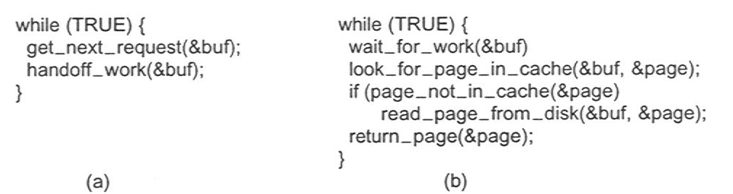
Example – Web Server with Web page cache
Dispatcher thread
Worker thread
A multithreaded Web server
Notes:
一个在万维网上的服务器，对页面的请求发给服务器，而所请求的页面发回给客户机。而在多数Web站点上，对某些页面的访问可能比其他页面多。利用这一事实，Web服务器可以把获得大量访问的页面的集合保存在主存中，避免到磁盘去调入这些页面，从而改善性能。这样一种页面集合称为高速缓存（cache）。
一种组织Web服务器的方式如下：
一个称为分派线程（dispatcher thread）的线程从网络中读入工作请求。在检查请求之后，分派线程挑选一个空转（即被阻塞的）工作线程（worker thread），提交给请求。接着分派线程唤醒休眠的工作线程，将它从阻塞状态转为就绪状态。
工作进程被唤醒后，它检查有关的请求是否在Web页面高度缓存之中，这个高速缓存是所有线程都可以访问的。如果没有，该线程从磁盘调入页面，并且阻塞直到完成页面的读入。在此过程中，为了完成更多的工作，分派线程可能挑选另一个线程运行，也可能是另一个当前就绪的工作线程投入运行。

Slide 11
Benefits
Responsiveness – may allow continued execution if part of process is blocked, especially important for user interfaces
Resource Sharing – threads share resources of process, easier than shared memory or message passing
Economy – cheaper than process creation, thread switching lower overhead than context switching
Scalability – process can take advantage of multicore architectures

Slide 12
Multicore Programming
Multicore or multiprocessor systems putting pressure on programmers, challenges include:
  Dividing activities
  Balance
  Data splitting
  Data dependency
  Testing and debugging
Parallelism implies a system can perform more than one task simultaneously
Concurrency supports more than one task making progress
  Single processor / core, scheduler providing concurrency

Slide 13
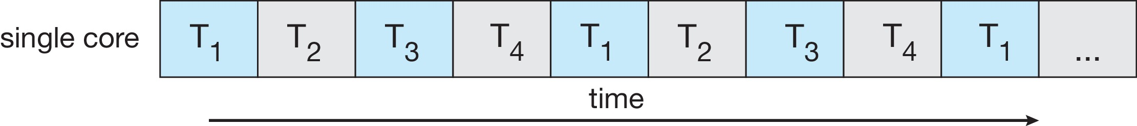
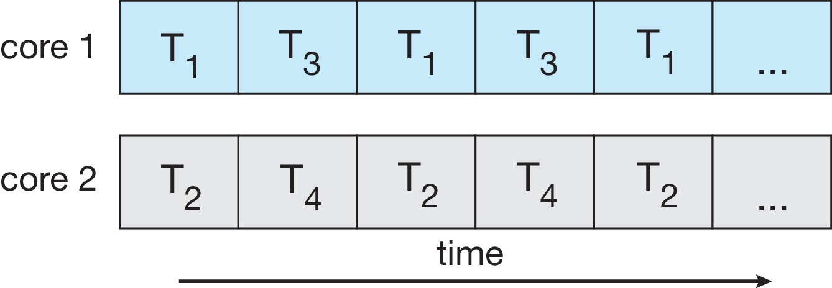
Concurrency vs. Parallelism
Concurrent execution on single-core system:
Parallelism on a multi-core system:

Slide 14
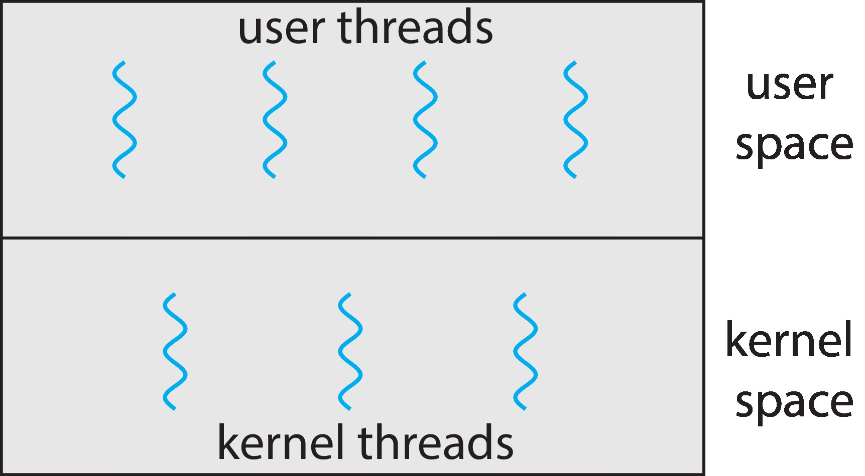
User Threads and Kernel Threads
User threads - management done by user-level threads library. There are three primary thread libraries:
  POSIX Pthreads
  Windows threads
  Java threads
Kernel threads - Supported by the Kernel. Virtually all general purpose operating systems, including:
  Windows, Linux, Mac OS X, iOS, Android

Slide 15
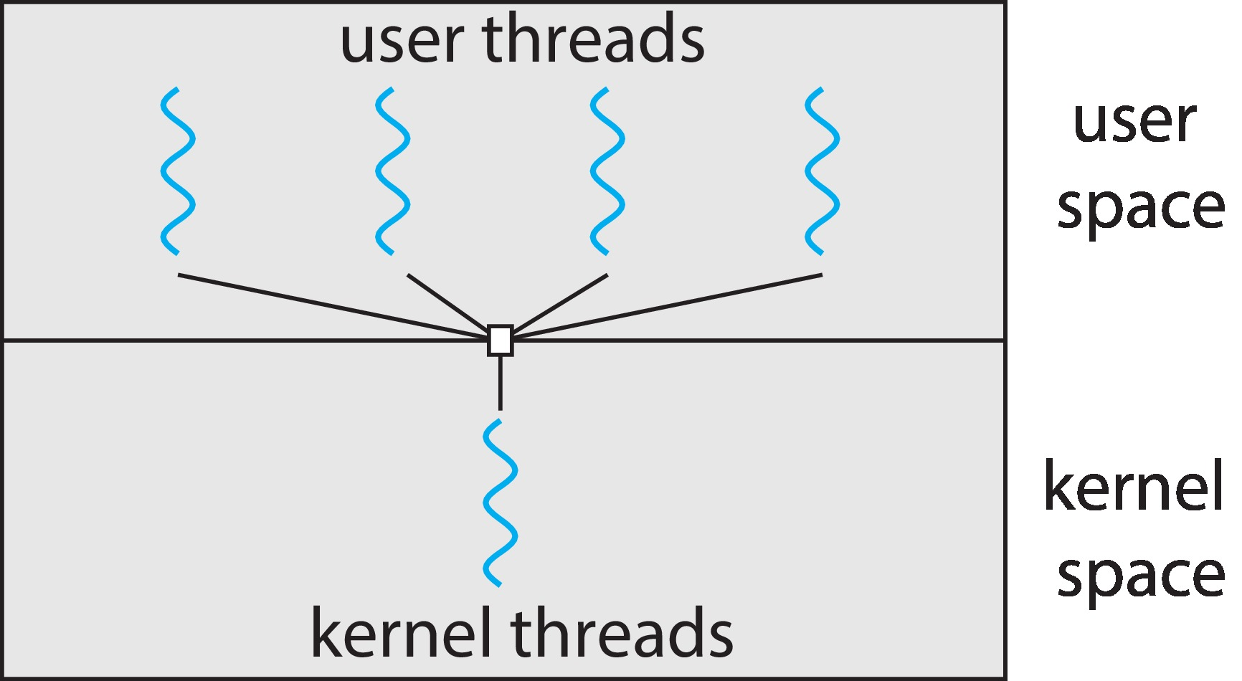
Multithreading Models
Many-to-One
  Many user-level threads mapped to single kernel thread
  One thread blocking causes all to block
  Examples:
    Solaris Green Threads
    GNU Portable Threads
One-to-One
Many-to-Many

Slide 16
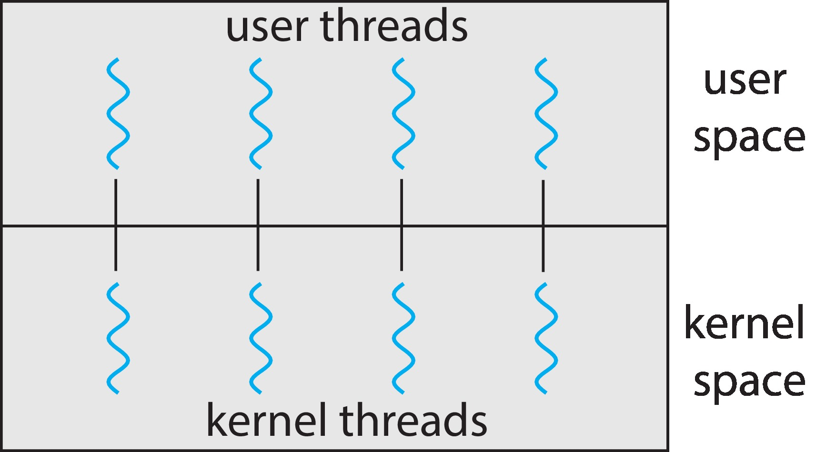
Multithreading Models
Many-to-One
One-to-One
  Each user-level thread maps to kernel thread
  Creating a user-level thread creates a kernel thread
  More concurrency than many-to-one
  Number of threads per process sometimes restricted due to overhead
  Examples
    Windows
    Linux
Many-to-Many

Slide 17
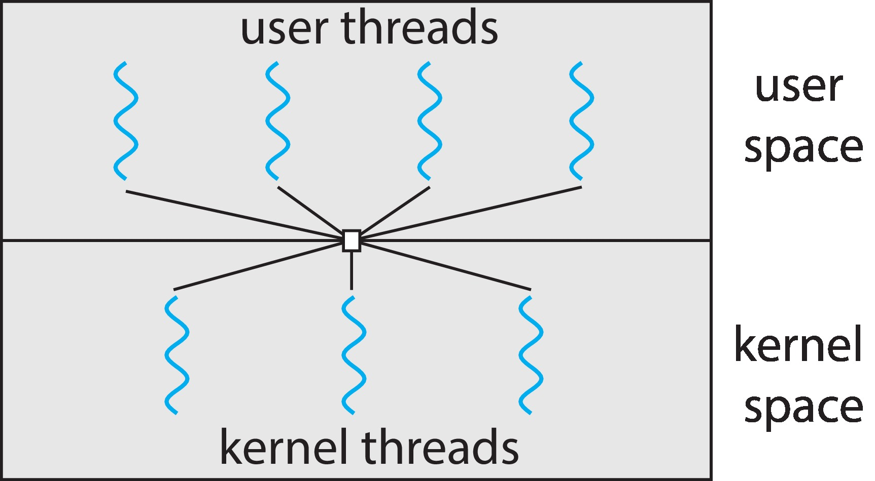
Multithreading Models
Many-to-One
One-to-One
Many-to-Many
  Allows many user level threads to be mapped to many kernel threads
  Allows the operating system to create a sufficient number of kernel threads
  Windows with the ThreadFiber package
  Otherwise not very common

Slide 18
Thread Libraries
Thread library provides programmer with API for creating and managing threads
Two primary ways of implementing
  Library entirely in user space
  Kernel-level library supported by the OS
Examples
  Pthreads
  Java Threads

Slide 19
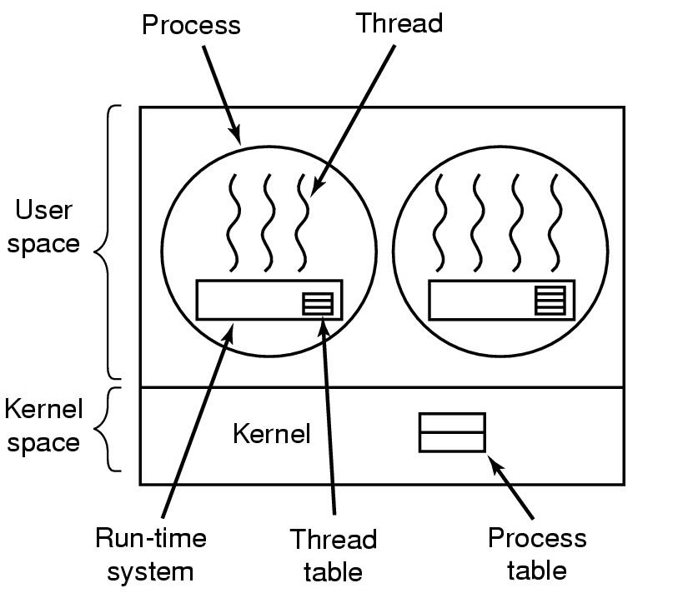
Implementation of user threads
Provides operations like thread_create, thread_exit, thread_wait, thread_yield and etc.
Traces threads and records attributes of threads.
Managed by run-time system, as the process table managed by kernel.
Notes:
线程在用户空间中，内核对线程一无所知，即内核仍然按单线程进程管理。
线程在一个运行时系统的顶部运行，该运行时系统是一个管理线程的过程的集合，包括：thread_create, thread_exit, thread_wait, thread_yield等。
在用户空间管理线程时，每个进程有一个专用的线程表，用来跟踪该进程中的线程，记录每个线程的属性，并由运行时系统管理。
在切换线程时，只要堆栈指针和程序计数器一被切换，新线程就自动投入运行。
优点：可以在不支持线程的操作系统上实现。允许用户自己定制调度算法，且具有良好的伸缩性。

Slide 20
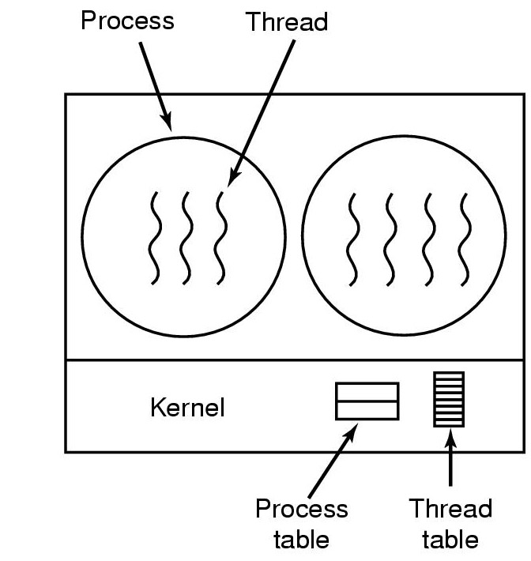
Implementation of kernel threads
Traces states of processes and records attributes of processes.
Subset of process table
Notes:
内核线程不需要运行时系统，每个进程也没有线程表，而是在内核中记录系统中所有线程的线程表。当某个线程希望创建一个新线程或撤销一个已有线程时，它进行一个系统调用，通过对线程表的更新完成线程的创建和撤销工作。
内核的线程表保存了每个线程的相关信息，是内核维护的单个进程信息的子集。此外，内核还维护了传统的进程表，跟踪进程状态。

Slide 21
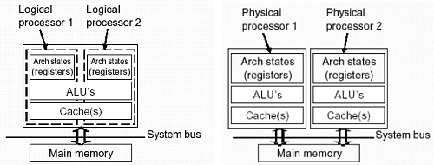
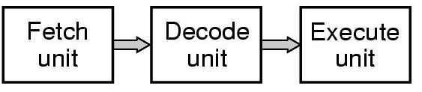
Hyper-Threading and dual-processor
Hyper-Threading
Dual processor system
How many clock cycles are needed in hyper-threading and dual-processor systems for a computational task with 6 clock cycles in single threads?
Notes:
Hyper Threading(超线程技术)：2001年10月15日，英特尔公司提出的一种处理器提速技术，让CPU可以同时执行多重线程，就能够让CPU发挥更大效率，即所谓“超线程（Hyper-Threading，简称“HT”）”技术。超线程技术就是利用特殊的硬件指令，把两个逻辑内核模拟成两个物理芯片，让单个处理器都能使用线程级并行计算，进而兼容多线程操作系统和软件，减少了CPU的闲置时间，提高CPU的运行效率。最早出现在2002年的Pentium4上，它是利用特殊的硬件指令，把两个逻辑内核模拟成两个物理芯片，让单个处理器都能使用线程级并行计算，进而兼容多线程操作系统和软件，减少了CPU的闲置时间，提高CPU的运行效率。基于Nehalem架构的Core i7再次引入超线程技术，使四核的Corei7可同时处理八个线程操作，大幅增强其多线程性能。
利用超线程(Hyper-Threading)技术可以让单物理内核的处理器通过模拟方式实现在对称处理模式下双处理器运行的效果。但是使用超线程技术的两个逻辑处理器并没有独立的执行单元、整数单元、寄存器甚至缓存等资源。它们的运行过程中仍需要共用执行单元、缓存和系统总线接口，在执行多线程时两个逻辑处理器均是交替的工作，如果两个线程都同时需要某一个资源时，其中一个要暂停并要让出资源，要待该资源闲置才能继续。而双核处理器中每个核心拥有独立的指令集、执行单元，可以同时执行多项任务，能让处理器资源真正实现并行处理模式，其效率和性能提升要比超线程技术高得多。例如:在执行某一运算任务时，在单线程情况下需要6个时钟周期，但双线程下就能在3个时钟周期内完成。如果使用超线程技术的单核处理器在某周期中出现重叠的情况就会导致某个线程出现延迟，那么整个运算周期可能会增加到4个。

Slide 22
Today we will discuss
Threads
Interprocess Communication （IPC）

Slide 23

Why IPC?
Processes within a system may be independent or cooperating
  Depends on whether they can affect or be affected by other running processes
Cooperating process can affect or be affected by other processes for:
  Information sharing
  Computation speedup
  Modularity
  Convenience
Cooperating processes need interprocess communication (IPC)
Notes:
需要提供环境以允许进程协作的原因：
1，信息共享，多个用户可能对同样的信息感兴趣，所以必须提供环境以允许对这些类型资源的并发访问。
2，加快计算，为加速一个任务的运行，可以将其分成子任务，每个任务与其他任务并行执行。
3，模块化，按模块化构造系统，可以将系统功能划分为独立进程或线程。
4，方便，每个用户可以执行多个任务。

Slide 24
Three models of IPC
Processes can communicate through
  shared memory: processes share some data structure or memory block;
  pipe: connect a reading process and a writing process, as the shared file for communication between the two processes;
  message passing: message is the unit of data transmission, which is much more useful for information transfer.
Notes:
目前，高级通信机制可归结为三大类：
共享存储器系统：相互通信的进程共享某些数据结构或共享存储区。进程之间能通过它们进行通信。例如，生产者-消费者问题中的buffer；
管道通信系统：管道指用于连接一个读进程和一个写进程，以实现它们之间通信的共享文件。
消息传递系统：进程之间的数据交换以消息为单位，可分为直接通信和间接通信。
IPC最好由消息传递系统提供。

Slide 25
Message passing
Processes communicate with each other by resorting to shared variables.
If P and Q wish to communicate, they need to:
  establish a communicate link (physical/logical) between them.
  exchange message via send/receive.

Slide 26
Implementation questions
How are the links formed ? (direct/indirect)
How many processes on each link?
How many links per pair of processes?
Capacity –buffer space- can massages be enqueued
Message formats and sizes. (fixed-sized/ variable sized)
Uni- or bidirectional
Notes:
如果进程P和Q需要通信，那么它们必须相互发送消息和接收消息；它们之间必须要有通信线路。
线路实现有物理实现和逻辑实现，这里只关心逻辑实现。
逻辑实现线路和发送/接收操作的方法：
直接或间接通信
对称或非对称通信
自动或显式缓冲
复制发送或引用发送
固定大小或可变大小消息

Slide 27
Direct communication-symmetric addressing
Processes must name each other explicitly
  send (P, message)
    Send a message to process P
  receive (Q, message)
    Receive a message from process Q
Properties of communication link
  Links are established automatically.
  A link is associated with exactly one pair of communication processes.
  Between each pair there exists exactly one link.
Notes:
直接通信，需要通信的进程必须明确地命名通信的接收者或发送者。采用这种方案，原语send和receive定义如下;
Send (P, message)发送消息到进程P；
Receive (Q, message)接收来自进程Q的消息。
该通信线路的属性：
需要通信的一对进程之间自动建立线路
一个线路只与两个进程相关
每对进程之间只有一个线路
该方式是对称寻址，即发送进程和接收进程必须命名对方，以便通信。该方案的一个变形采用非对称寻址。只要发送者命名接收者，而接收者不需要命名发送者，原语定义为：
Send (P, message)发送消息到进程Ｐ
Receive (id, message)接收来自任何进程的消息，变量id设置成与其通信的进程名称

Slide 28
Direct communication-asymmetric addressing
Only the sender names the recipient, and the recipient is not required to name the sender.
  send (P, message)
    Send a message to process P
  receive (id, message)
    Receive a message from any process, id is set to the name of sender
  E.g., a process which provides print service
Notes:
用于提供打印服务的进程，它可以接收来自任何一个进程的“打印请求”消息，此时接收原语为receive(id, message)。

Slide 29

Direct communication-disadvantages
Need to know the names of processes
Limited modularity
  As changing the identifier of a process, all references to the old identifier must be found, so they can be modified to the new identifier.
Indirect communication
Notes:
直接访问的缺点是限制了结果进程定义的模块化，改变进程的名字可能必须检查所有其他进程定义。所有就名称的引用都必须被找到，一遍修改成为新名字。

Slide 30
Indirect communication
Messages are sent to and received from mailboxes or ports.
  send (A, message)
    Send a message to mailbox A
  receive (A, message)
    Receive a message from mailbox A
Mailboxes can be viewed as:
  The places messages can be placed into or removed out by different processes.
  Each mailbox has a unique id.
  Processes can communicate only if they share a mailbox.
Notes:
间接通信：消息通过邮箱或端口来发送和接收。每个邮箱都有一个唯一的标识符，一个进程能通过不同的邮箱与其它进程进行通信。原语定义为：
Send (A, message)发送一个消息到邮箱A
Receive (A, message)接收来自邮箱A的消息

Slide 31
Indirect communication
Properties of communication link:
  Link established only if processes share a common mailbox.
  A link may be associated with many processes.
  Each pair of processes may share several communication links.
  Links may be unidirectional or bi-directional.
  Mailbox can be owned by a process or OS.
    Create a new mailbox
    Send and receive messages through mailbox
    Destroy a mailbox
Notes:
通信线路属性为：
只要一对进程中的两个成员共享一个邮箱即可建立通信线路
一个线路可以与两个或更多的进程相关联
两个通信进程之间可能有多个不同的线路，每个线路对应一个邮箱
链接可以是单向的或双向的
邮箱可以由进程或操作系统提供，允许如下操作：
创建一个新邮箱
通过邮箱发送和接收消息
删除一个邮箱

Slide 32

Indirect Communication
How about three processes?
  P₁, P₂, and P₃ share mailbox A.
  P₁, sends; P₂ and P₃ receive.
  Who gets the message?
  Solutions
    Allow a link to be associated with at most two processes.
    Allow only one process at a time to execute a receive operation.
    Allow the system to pick arbitrarily the receiver and notify the sender who the receiver was.
Notes:
现假设进程P1、P2和P3都共享邮箱A。进程P1发送一个消息到A，而进程P2和P3都对A执行receive。哪个进程能收到P1所发的消息呢？
允许一个线路最多只能与两个进程相关联
允许一次最多一个进程执行receive操作
允许系统随意选择一个进程以接收消息。系统可以告诉发送者谁是接收者。

Slide 33
IPC synchronization
The communication of a message between two processes implies some level of synchronization.
  The receiver cannot receive a message until it has been sent by another process.
Message passing may be either blocking or non-blocking (also known as synchronous and asynchronous)

Slide 34
IPC synchronization
Send and receive primitives may be either blocking or non-blocking.
  Blocking send: the sending process is blocked until the massage is received.
  Non-blocking send: the sending process sends the message and resumes the operation.
  Blocking receive: the receiver blocks until a message is available.
  Non-blocking receive: the receiver retrieves either a valid message or a null.
Different combinations of send() and receive() are possible.
  Non-blocking send and blocking receive is the common one.
Notes:
进程间的通信可以通过调用原语send和receive来进行。消息传递可以是阻塞或非阻塞，也称为同步或异步。
阻塞send：发送进程阻塞，直到消息为接收进程或邮箱所接收
非阻塞send：发送进程发送消息并再继续操作
阻塞receive：接收者阻塞，直到有消息可用
非阻塞receive：接收者收到一个有效消息或无效消息

Slide 35
IPC buffering
Queues of messages attached to the link, include:
  Zero capacity (queue length=0)
    The sender must wait until the receiver is ready to take the message.
  Bounded capacity (queue length=n)
    If the link is full, the sender must block until space is available in the queue.
  Unbounded capacity (queue length=∞)
    Any number of messages can wait in it, the sender never blocks.
Notes:
不管直接或间接通信，通信进程所交换的消息都驻留在临时队列中。
队列实现有三种方法：
零容量：队列的最大长度为0，因此，线路中不能有任何消息处于等待。此时，发送者必须阻塞，直到接收者接收到消息。
有限容量：队列的长度为有限的n，因此，最多只能有n个消息驻留其中。此时，如果消息队列未满，消息要放在队列中，发送者可继续执行而不必等待。但线路满时，发送者必须等待知道队列中的空间可用为止。
无限容量：队列长度无限，不管多少消息都可在其中等待。发送者从不阻塞。

Slide 36
Example - Producer-Consumer Problem
A producer process "produces" information "consumed" by a consumer process.
  unbounded-buffer places no practical limit on the size of the buffer.
  bounded-buffer assumes that there is a fixed buffer size.
producer
consumer
Notes:
生产者进程产生信息，以供消费者进程消费。
为了允许生产者和消费者进程能并发执行，需要一个项目缓冲区来被生产者填充或被消费者使用。当消费者使用一项时，生产者可以同时生产另一项。当缓冲区为空时，消费者必须等待一项被生成出来，而不能使用未生产的项。
无限缓冲区生产者消费者问题对缓冲区大小没有实际限制，虽然消费者需要等待新项，但生产者可以不断生产。
有限缓冲区生产者消费者问题假设缓冲区大小是固定的，因此，如果缓冲区为空，消费者必须等待；相反，如果缓冲区为满，生产者必须等待。

Slide 37
Example: Producer – Consumer Problem
Consider that “Does it work correctly?
#define BUFFER_SIZE 10
typedef struct {
DATA data;
} item;
item buffer[BUFFER_SIZE];
int in = 0;
int out = 0;
int counter = 0;
in
buffer
data0 | data1 | …… | data9
out

Slide 38
Example: Producer – Consumer Problem
Consider that “Does it work correctly?
#define BUFFER_SIZE 10
typedef struct {
DATA data;
} item;
item buffer[BUFFER_SIZE];
int in = 0;
int out = 0;
int counter = 0;
item nextProduced;
while (TRUE) {
  while (counter == BUFFER_SIZE);
  buffer[in] = nextProduced;
  in = (in + 1) % BUFFER_SIZE;
  counter++;
}
PRODUCER

Slide 39
Example: Producer – Consumer Problem
Consider that “Does it work correctly?
#define BUFFER_SIZE 10
typedef struct {
DATA data;
} item;
item buffer[BUFFER_SIZE];
int in = 0;
int out = 0;
int counter = 0;
item nextProduced;
while (TRUE) {
  while (counter == BUFFER_SIZE);
  buffer[in] = nextProduced;
  in = (in + 1) % BUFFER_SIZE;
  counter++;
}
PRODUCER
item nextConsumed;
while (TRUE) {
  while (counter == 0);
  nextConsumed = buffer[out];
  out = (out + 1) % BUFFER_SIZE;
  counter--;
}
CONSUMER

Slide 40
Objectives
Identify the basic components of a thread, and contrast threads and processes
Describe the benefits and challenges of designng multithreaded applications
Illustrate different approaches to implicit threading including thread pools, fork-join, and Grand Central Dispatch
Describe how the Windows and Linux operating systems represent threads
Design multithreaded applications using the Pthreads, Java, and Windows threading APIs

Slide 41
Processes and threads - 3

